Slide 1
Texas Community Development Block Grant Program
TDA-GO Materials and Services Report
Notes:
Welcome to CDBG Over Coffee. My name is Catrina Pulido and I am a Grant Coordinator with the CDBG Program. I will be walking you through Labor Standards in TDA-GO! Should you have any questions there will be time following the presentation.

Slide 2
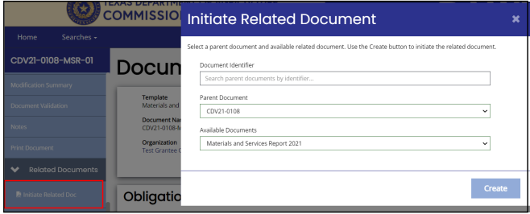
Initiate MSR
A new MSR is required for each prime contract (services or construction)
Open the agreement to start the MSR
Scroll down to Related Documents section and click Initiate Related Document.
Under Available Documents, click Materials and Service Report
Notes:
To initiate the MSR navigate to the Related Documents on the left sidebar menu. Then click on initiate related doc and from the dropdown menu under available documents select materials and services report. Then click create.

Slide 3
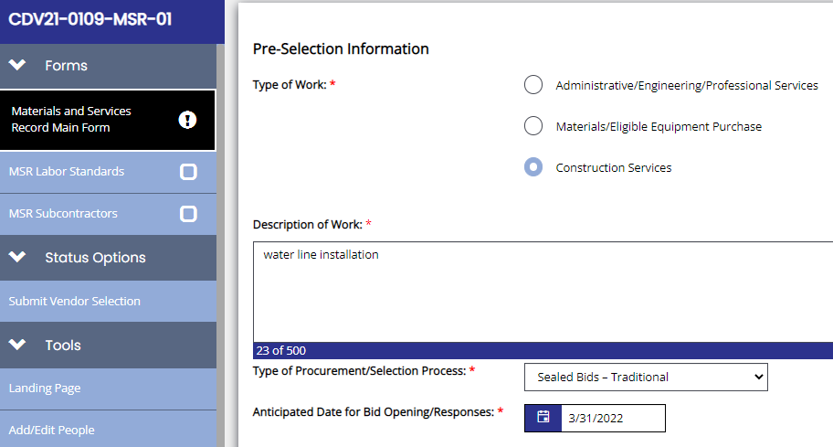
MSR Pre-Selection Info
Complete when planning procurement
Each of the Pre-Selection fields is required
Additional fields depend on “Type of Work” selected
Save once complete

Slide 4
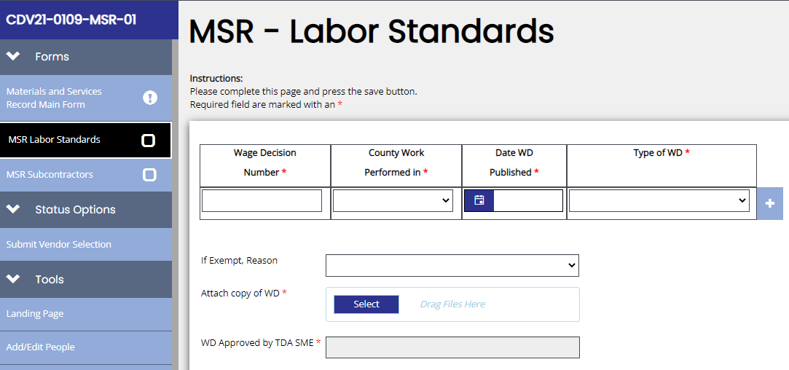
MSR Pre-Selection Info, cont.
For construction MSRs, Labor Standards form must be completed. (Left navigation bar)
Save once complete

Slide 5
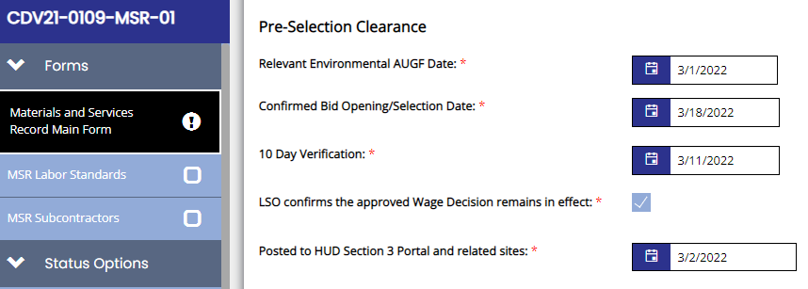
MSR Pre-Selection Clearance
As the procurement date nears, complete visible Pre-Selection Clearance fields
Save once complete

Slide 6
MSR Pre-Selection Clearance, cont.
Confirmed Bid Opening/Selection Date
Sealed bid opening
Small purchase quotes due
Service provider RFP/RFQ response due date

Slide 7
MSR Pre-Selection Clearance, cont.
10 Day Verification: 5-10 days prior to bid opening
LSO confirmation: once wage rate is confirmed to remain in effect

Slide 8
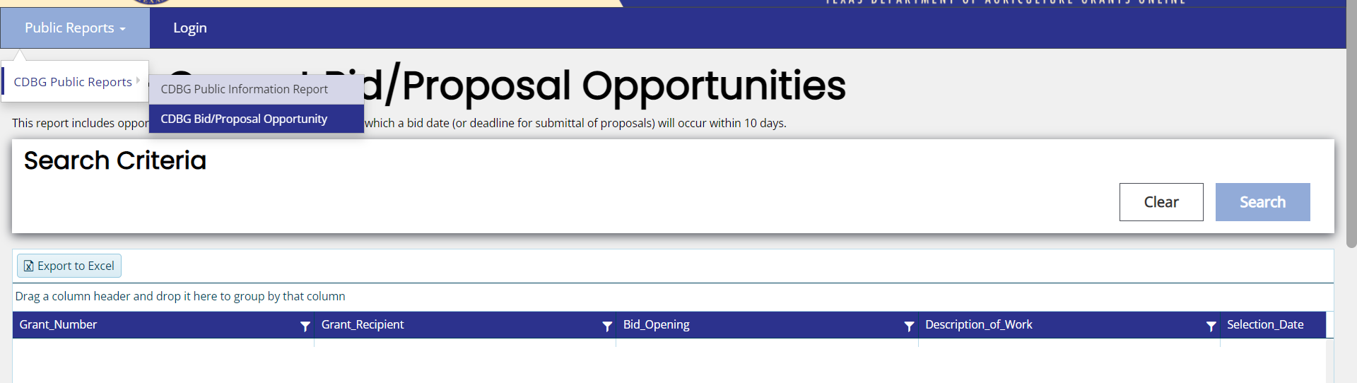
MSR Pre-Selection Clearance, cont.
Section 3 portal: at least 10 days prior to bid opening
This date populates the public report of upcoming bid opportunities

Slide 9
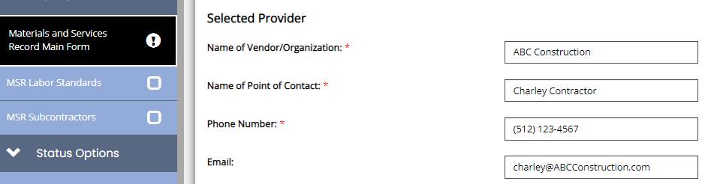
MSR Selected Provider & Process
Once vendor /provider is selected, complete fields to identify successful firm/individual

Slide 10
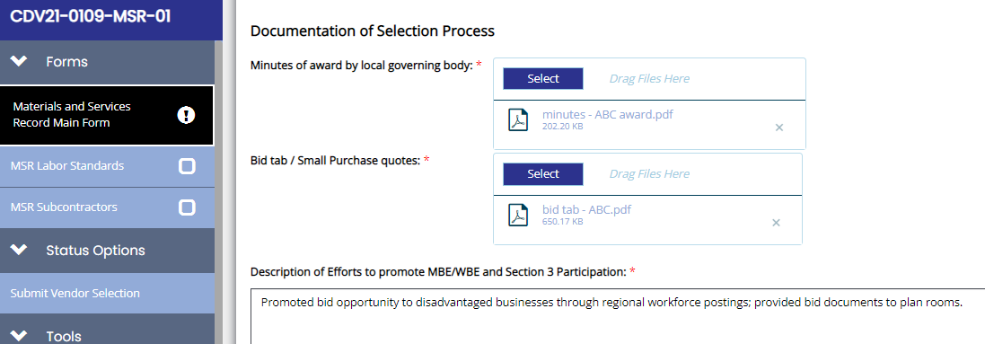
MSR Selected Provider & Process, cont.
Attach minutes of award by local governing body.
Attach record of competitive procurement
Bid tab
A504 Small Purchase record
A508 Evaluation of Proposals (or similar)

Slide 11
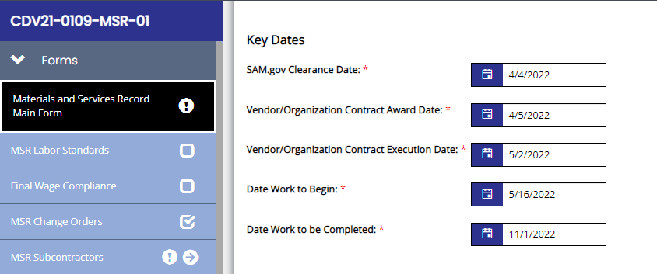
MSR Selected Provider & Process, cont.
Enter key dates for the provider contract

Slide 12
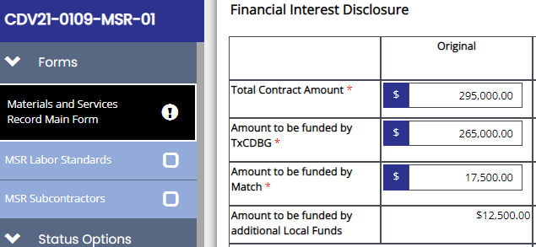
MSR Financial Interest Disclosure
Enter Total Contract Amount
Assign Grant and Match amounts
Page will calculate local amount that exceeds match

Slide 13
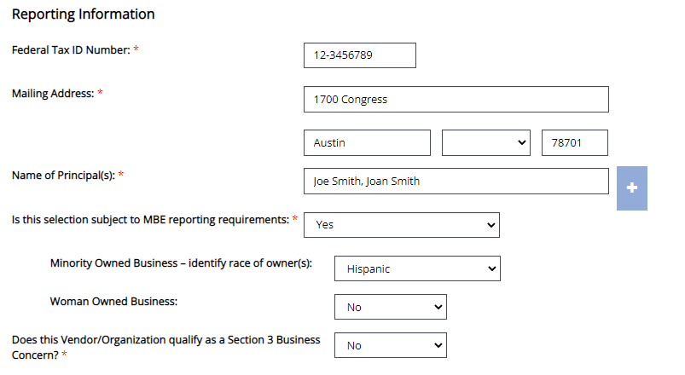
MSR Financial Interest Disclosure
Enter provider information for federal reporting
Federal Tax ID number = 9 digits (not SSN)
MBE / WBE = majority ownership

Slide 14
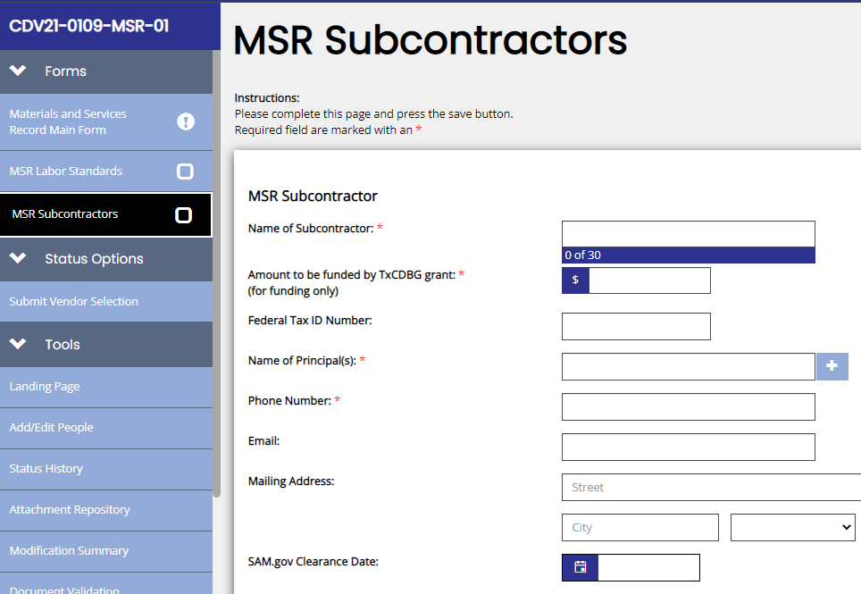
MSR Subcontractors
For subcontractors for a prime, complete the MSR Subcontractor form (left navigation bar)
Federal reporting data is required for each subcontractor.

Slide 15
MSR Subcontractors, cont.
Add a new subcontractor by clicking “Add” in upper right corner.
View all subcontractor pages using the arrow icon in the left navigation bar
Subcontractor pages may be added until MSR is complete

Slide 16
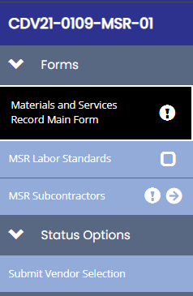
Submit MSR
Using the left navigation bar, under Status Options, click Submit Vendor Selection
TDA staff will review and approve
Once submitted and approved, Main Form can only be revised by Change Order

Slide 17
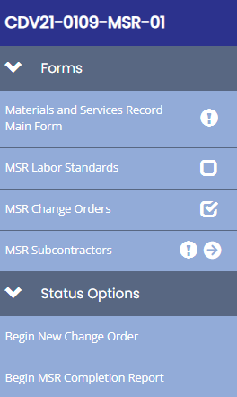
MSR - Next Status Steps
To take certain actions, you must change the status of the MSR
To start a new change order
To document a vendor contract as complete
Notes:
Subcontractors can be added any time

Slide 18
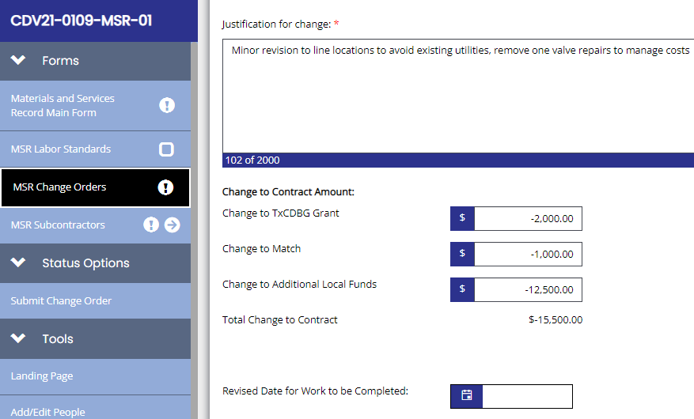
MSR Change Orders
For each change order, complete the MSR Change Orders from

Slide 19
MSR Change Orders, cont.
Complete all questions
Attach the change order document prepared by the engineer for the contract
Notes:
Not A505

Slide 20
MSR Change Orders
Check the data entry by reviewing the MSR Main form

Slide 21
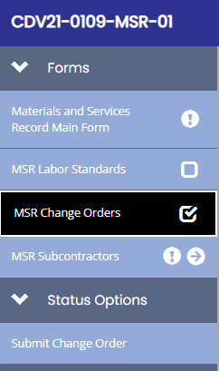
Submit Change Order
Using left navigation bar, under Status Options, click Submit Change Order
TDA staff will review and accept
Any costs not approved for the grant/match will be identified

Slide 22
MSR - Completion Step
Once all information is entered, under Status Options, click Begin MSR Completion Report
all change orders
all subcontractors
New pages will appear

Slide 23
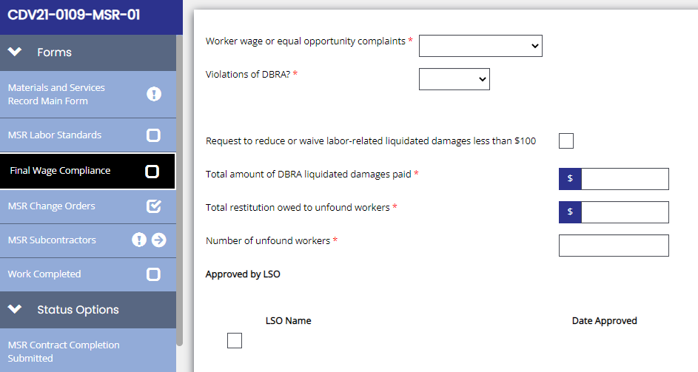
MSR – Completion Step, cont.
LSO must complete and certify Final Wage Compliance form

Slide 24
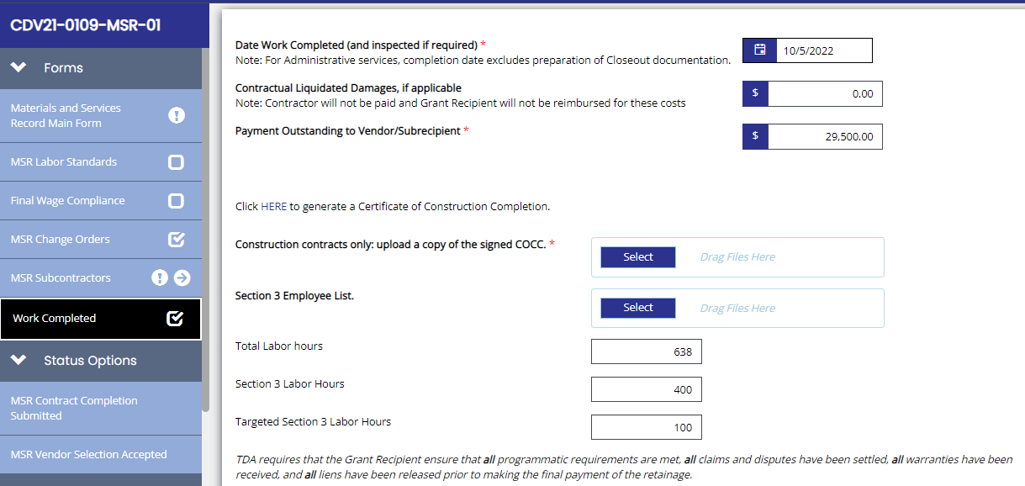
MSR – Completion Step, cont.
Complete all fields on Work Completed form

Slide 25
MSR – Completion Step, cont.
Once data is entered, click the word HERE to generate a Certificate of Construction Completion.
Obtain signatures and attach COCC

Slide 26
Submit Contract Completion
Using left navigation bar, under Status Options, click MSR Contract Completion Submitted to send to TDA for review
To cancel the completion step, click MSR Vendor Selection Accepted

Slide 27
Helpful Tools
In Related Documents section, click Materials and Services Report for a cumulative total of funds obligated on all MSRs to date

Slide 28
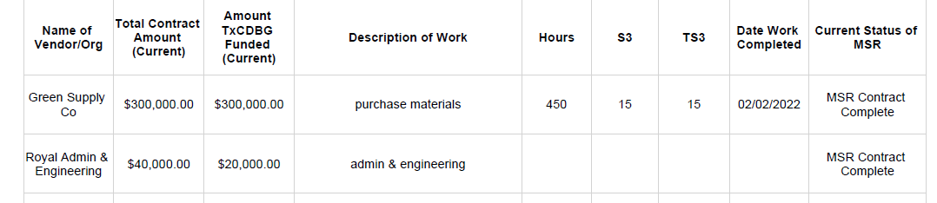
Helpful Tools
Coming Soon: MSR Report

Slide 29
Questions?
CDBGReporting@TexasAgriculture.gov
Notes:
Thank you for joining us this afternoon. We will now answer any questions you may have.

