Slide 1
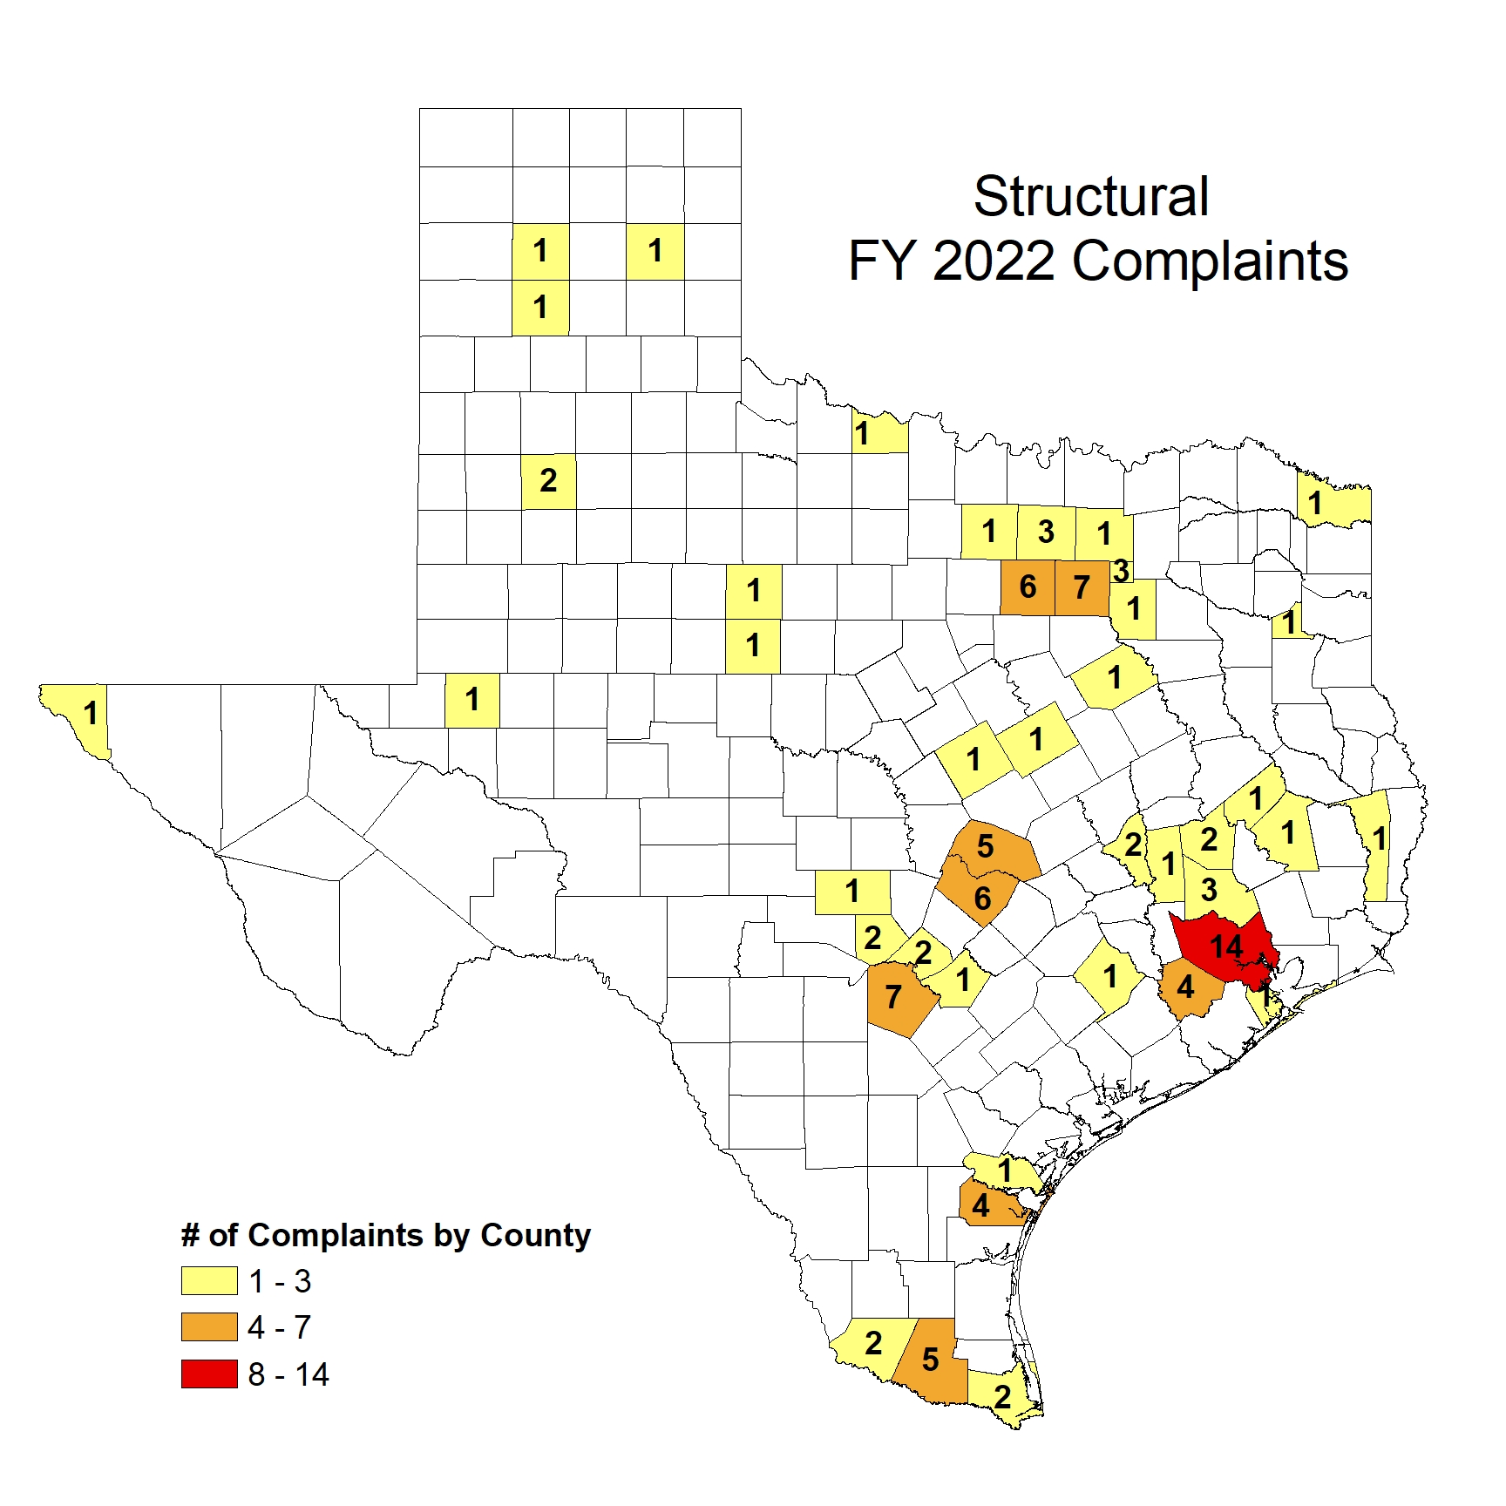
SPCS FY 2022(107) Complaints Received
Human Exposure (12)
Misapplications (18)
Unlicensed (44)
WDIR (5)
Other (28)
Failure to Register
Termite Disclosures
Posting
Supervision/Training

Slide 2
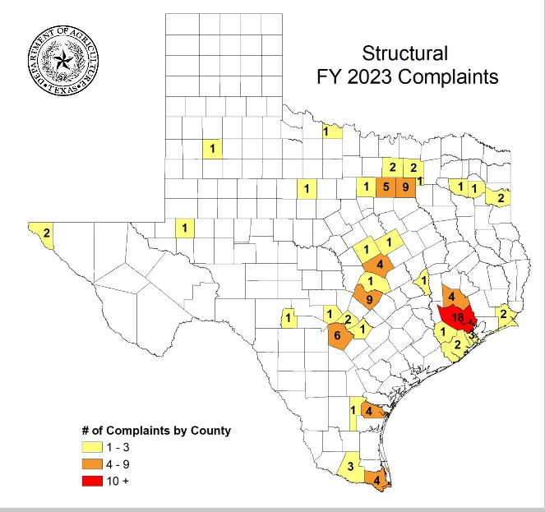
SPCS FY 2023 (100) Complaints Received
Human Exposure (10)
Misapplications (16)
Unlicensed (41)
School IPM (1)
WDIR (5)
Other (27)
Failure to Register
Termite Disclosures
Posting
Supervision/Training
Notes:
100 complaints

Slide 4
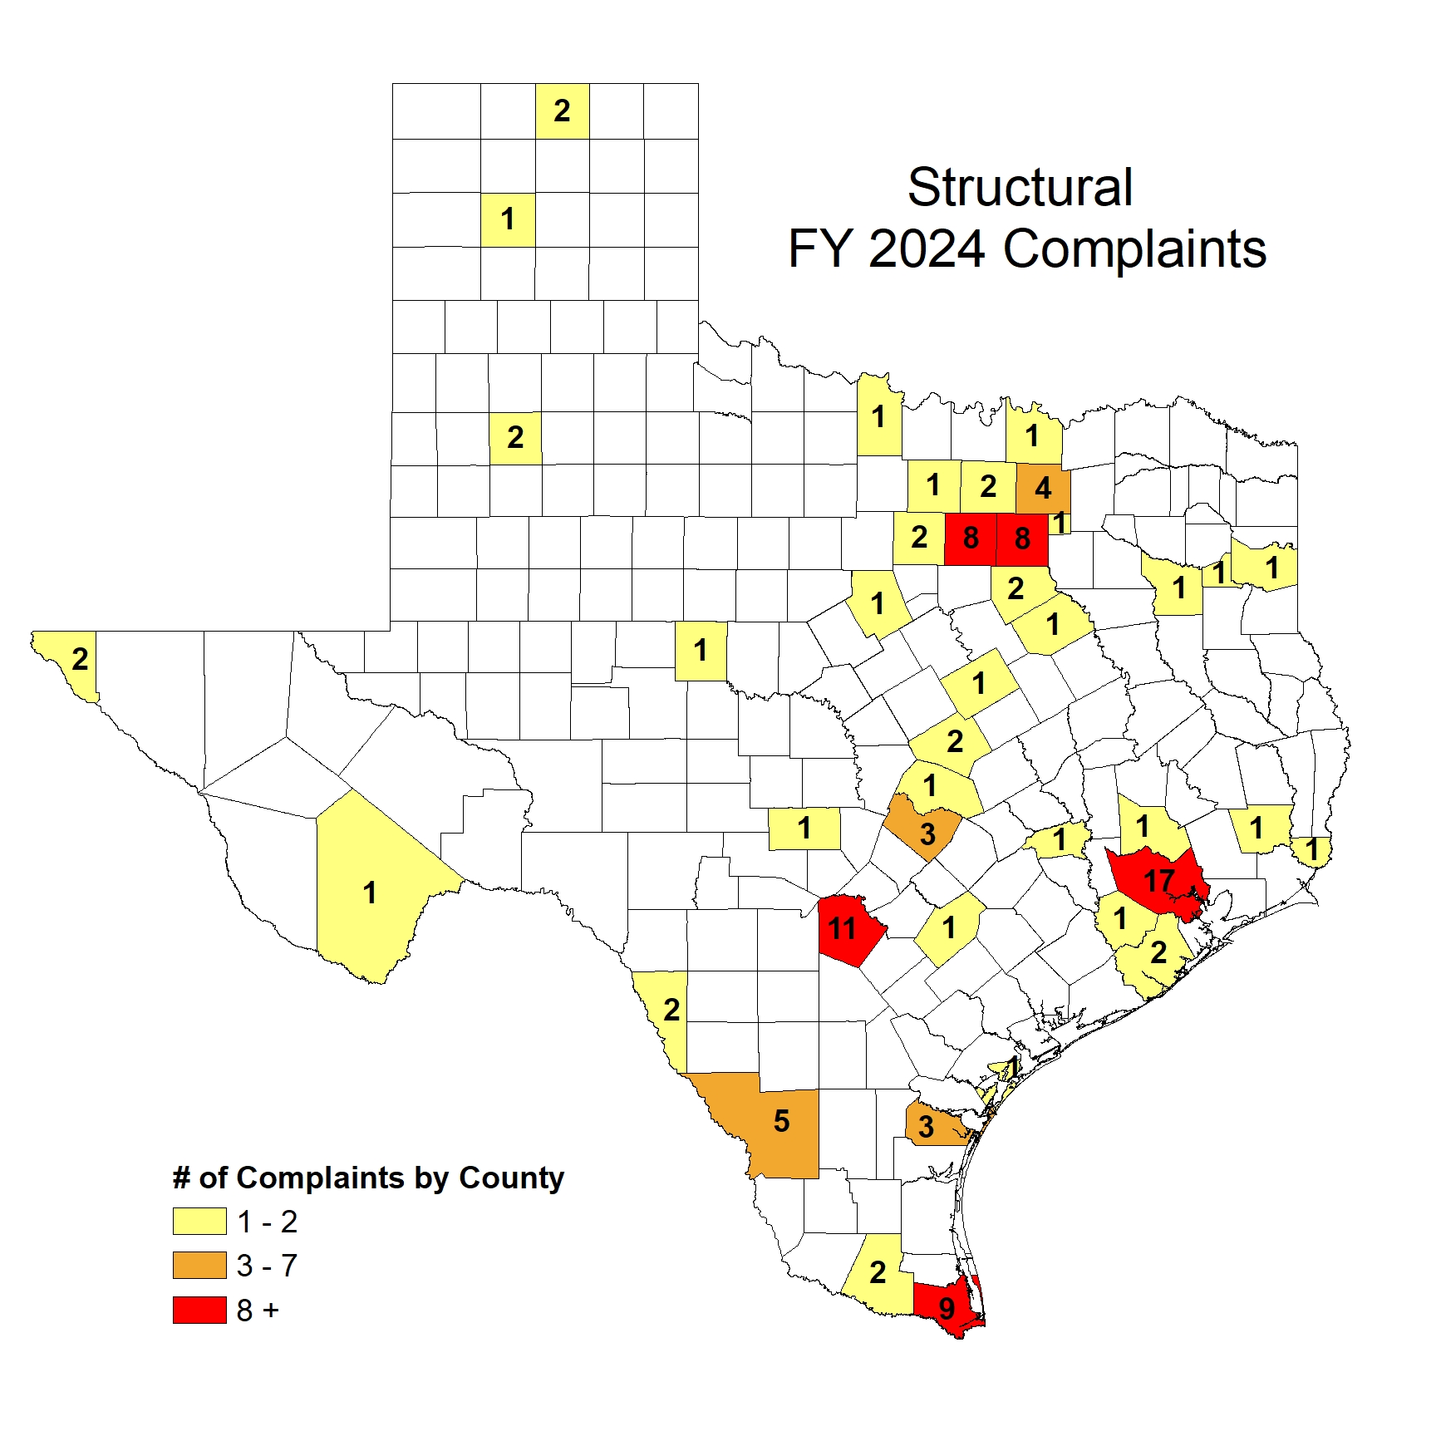
SPCS FY 2024 (113) Complaints Received
Human Exposure (7)
Misapplications (17)
Unlicensed (56)
School IPM (1)
WDIR (5)
Other (27)
Failure to Register
Termite Disclosures
Posting
Supervision/Training
Notes:
Total complaints 113

Slide 5
Notes:
School IPM is technically <1% (.8%) indicated as 1 otherwise it doesn’t show up

Slide 6
SPCS Complaints By Month
Notes:
November had no complaints in November FY 2023 & FY 2024

